Slide 1
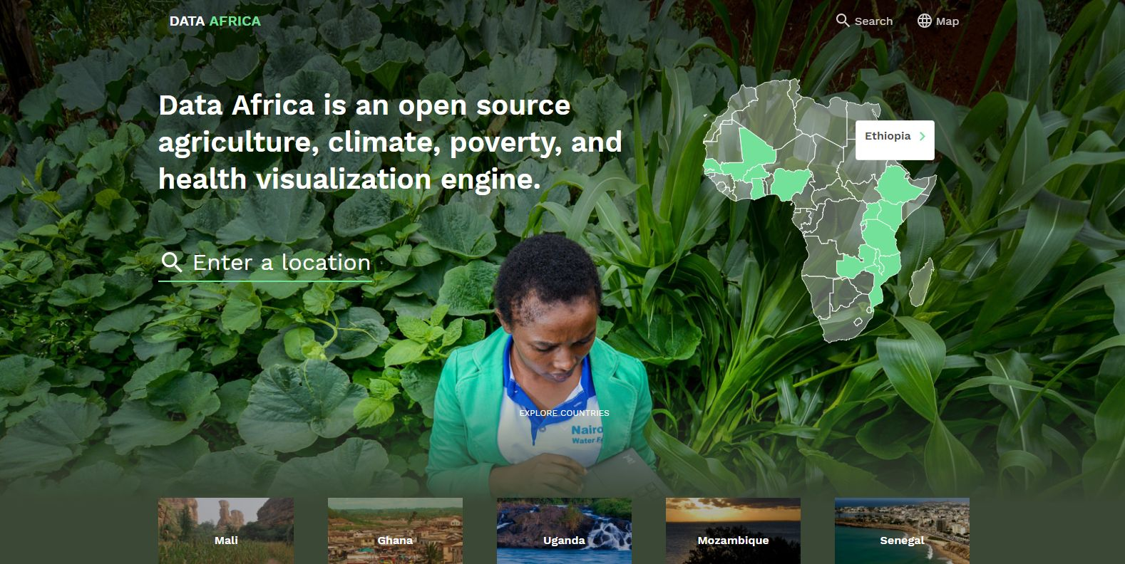
Use of large, textural pictures are vibrant, savvy, welcoming, but doesn’t detract from content
Minimal nav/header with intuitive anchors
Minimalist search & anchor
Tiles allow for easy visual aid/navigation.

Slide 2

Although plain language - detracts from content/visual navigation
Personal voice; plain language
Plain language/use of tiles for visual & hierarchical nav

Slide 3
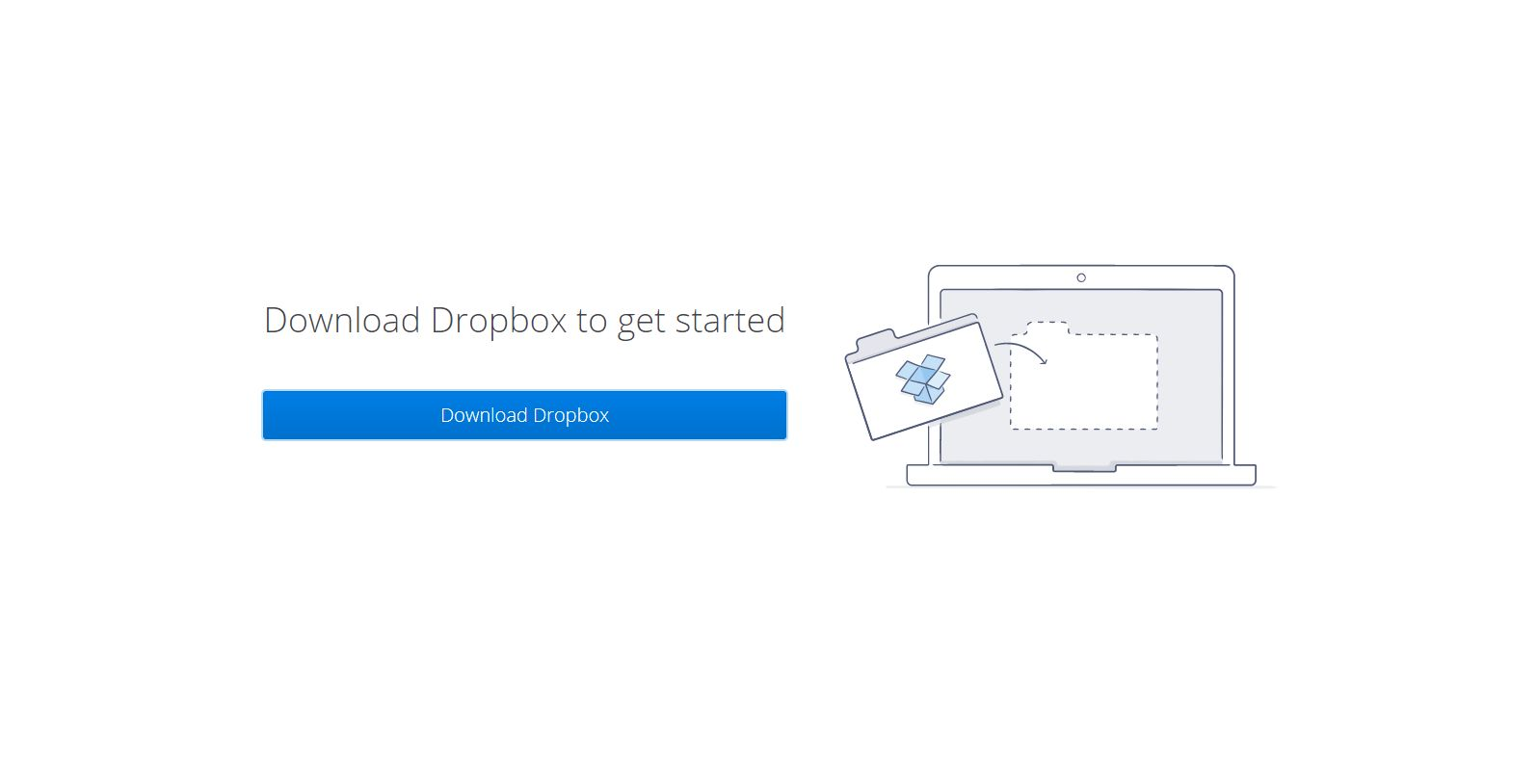
Minimalist introduction & tutorial

Slide 4
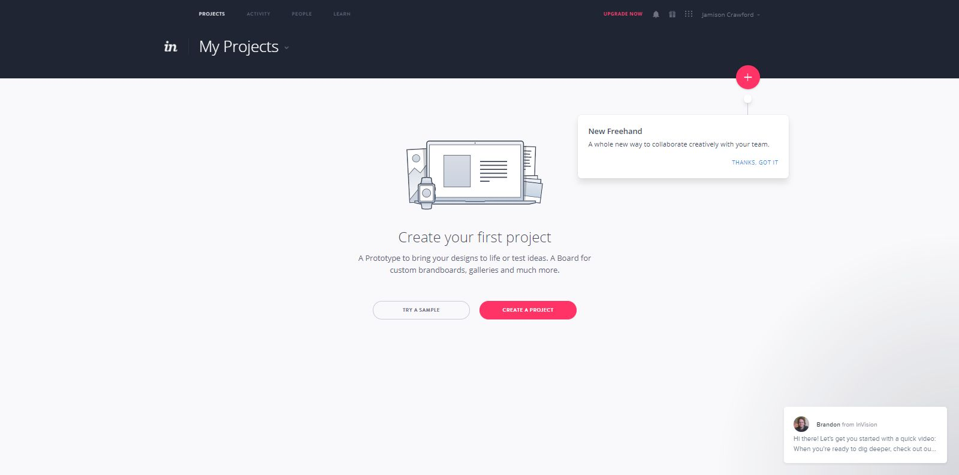
Intuitive, savvy image
“Thanks, I got it” text to end tutorial early
Minimalism
Limited options to ensure hierarchical navigation

Slide 5
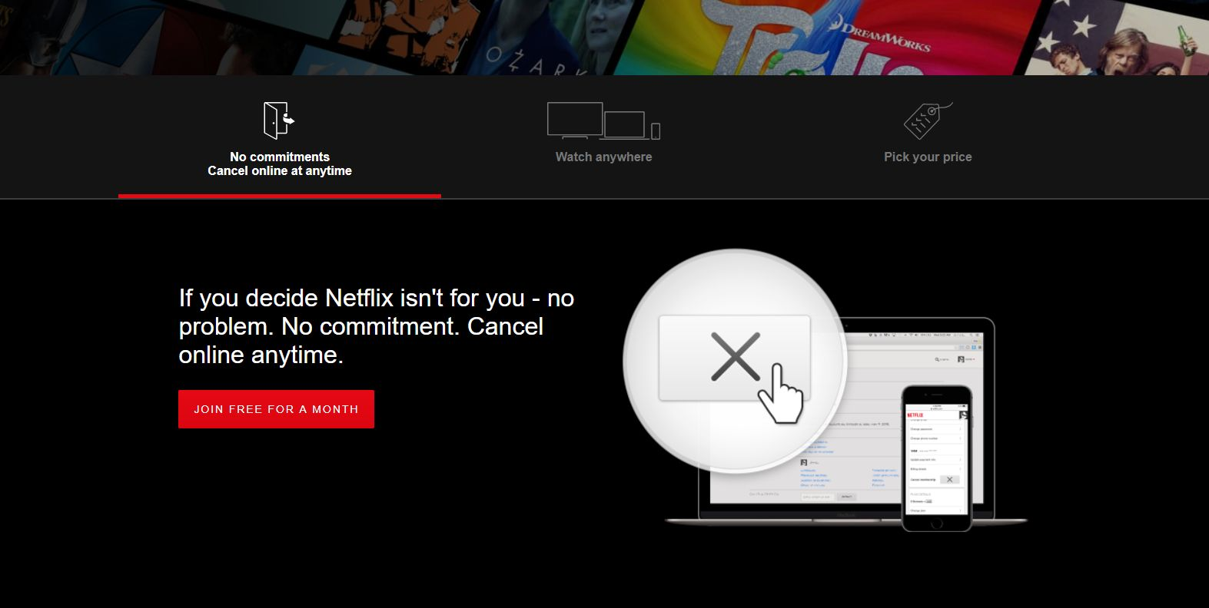
Textural, savvy image sans distraction
Icons & short section titles; terse tutorial
Brief statement & call to action
Intuitive visual aid for text

Slide 6
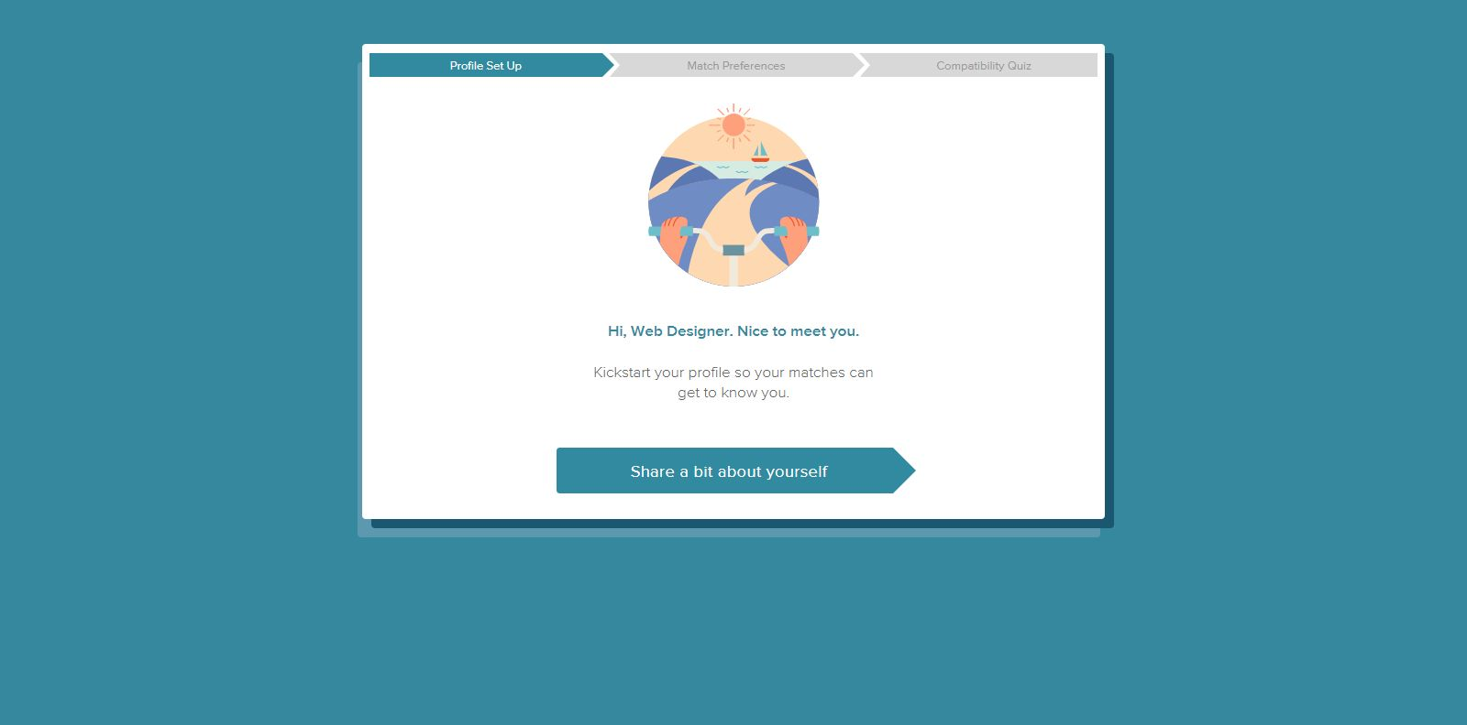
Progress meter
Personal, informal tone; plain language
Minimalism

Slide 7
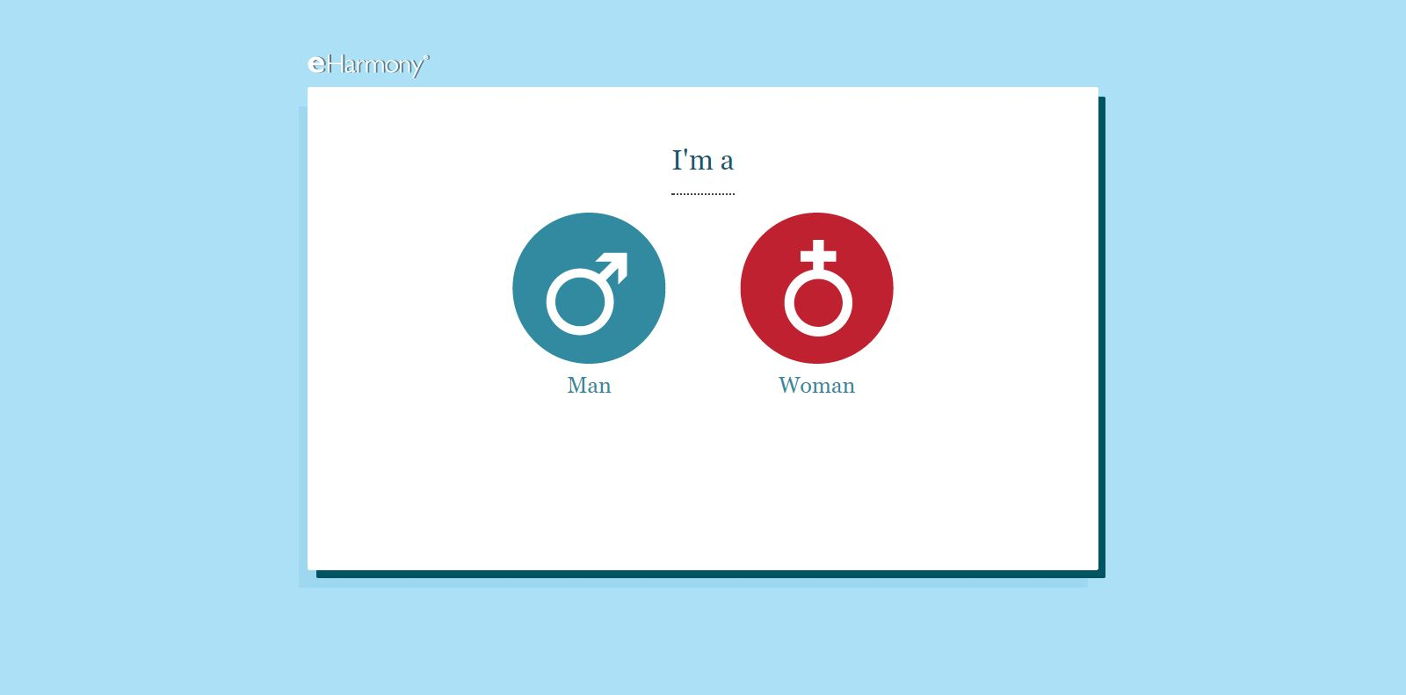
Extremely minimalist profile demography entry

Slide 8
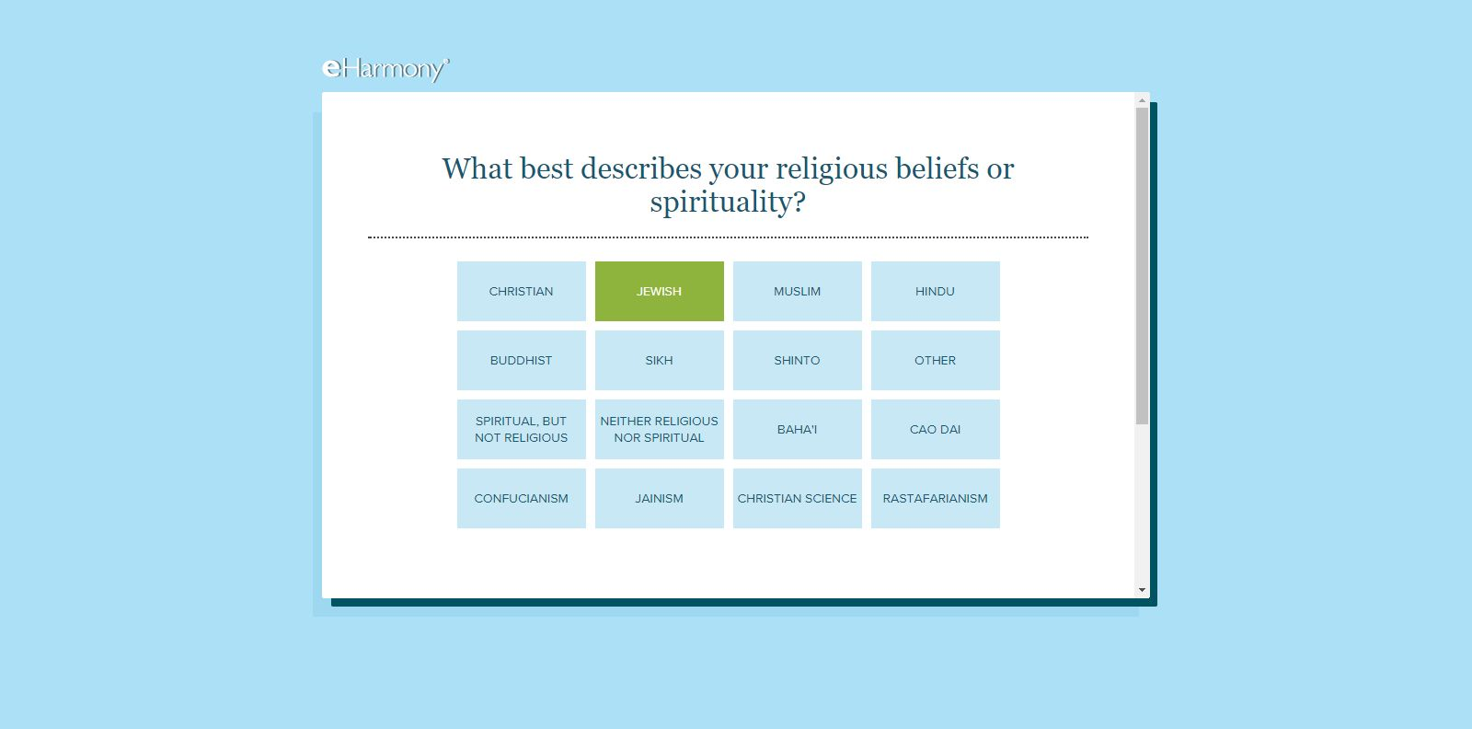
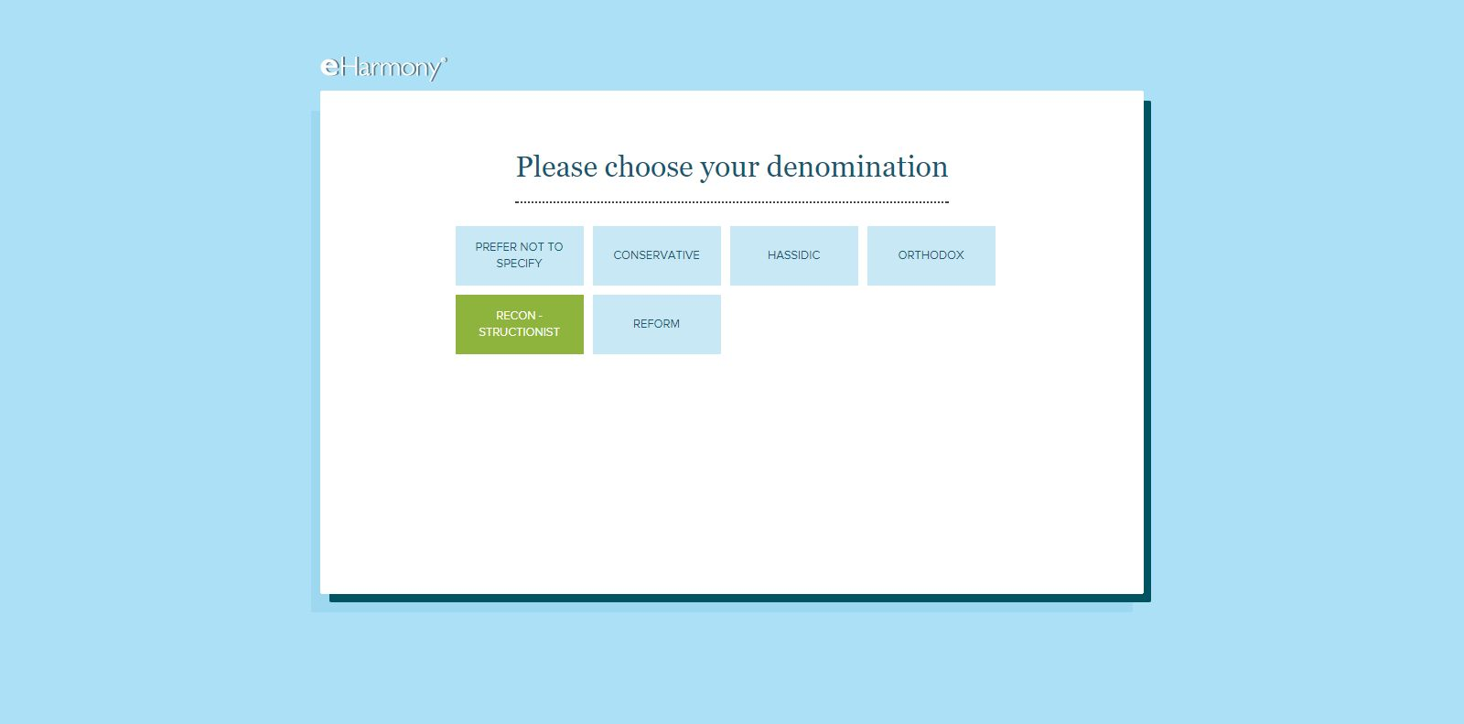
Dynamic/procedurally-generated data entry

Slide 9
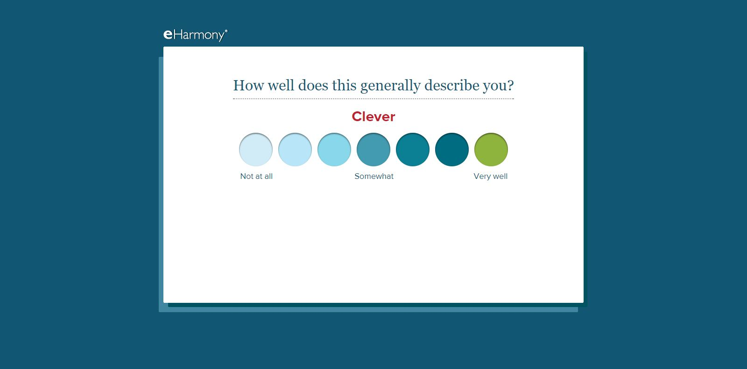
Never textual inundation, at any time
Simple Likert scales
Minimalism

Slide 10
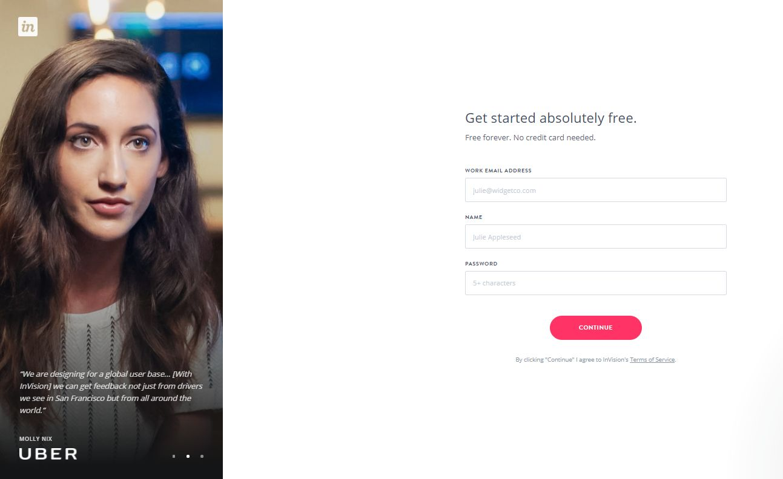
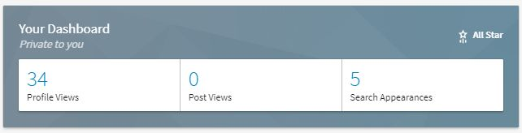
Liberal use of large, high-resolution images
Gamification via profile ranking
Profile splash/dash should include data viz
Inspirational quote, testimonial, factoid, etc.
Minimalist nav

Slide 11
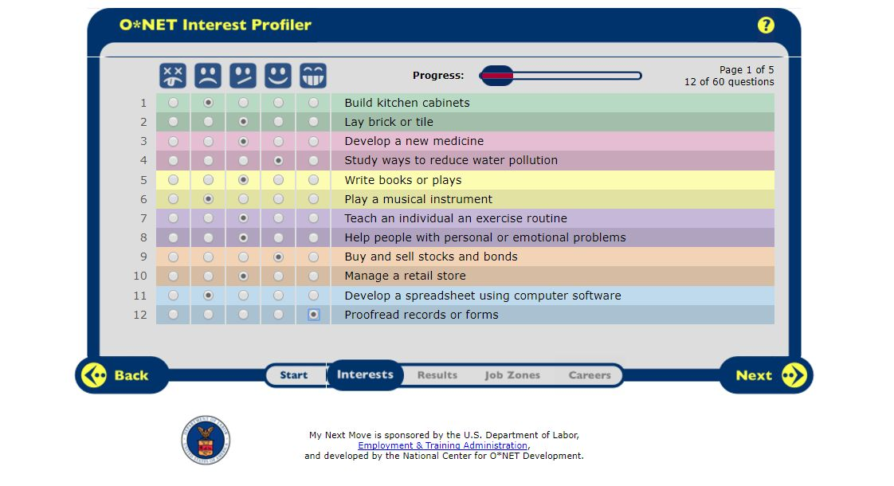
Intuitive anchors for Likert scales
Progress meter
Too much text; not plain language; should be replaced with images

Slide 12
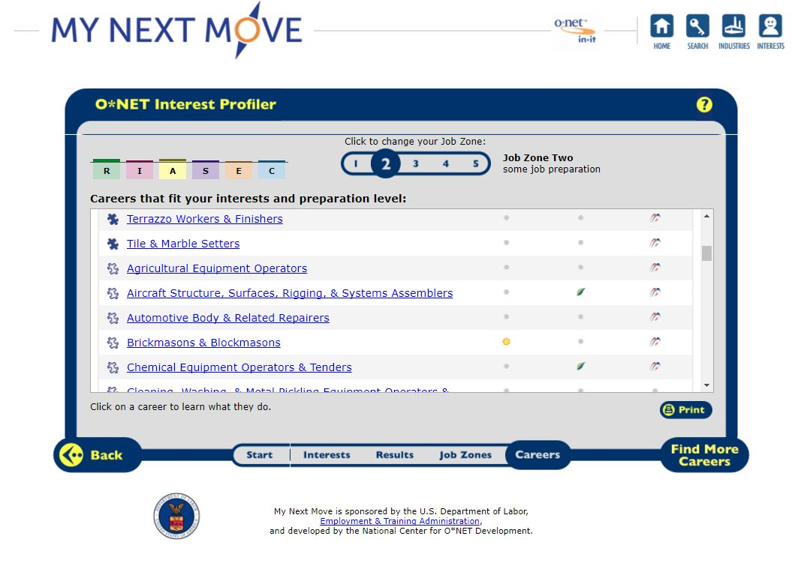
Visualization of RIASEC interest variables
Option to change filters
Matching results state additional filters
RIASEC variables should be replaced with icons
Icons quickly convey “best” and “great” fit
Icons quickly convey employment projections, “green” jobs, and available apprenticeships

Slide 13
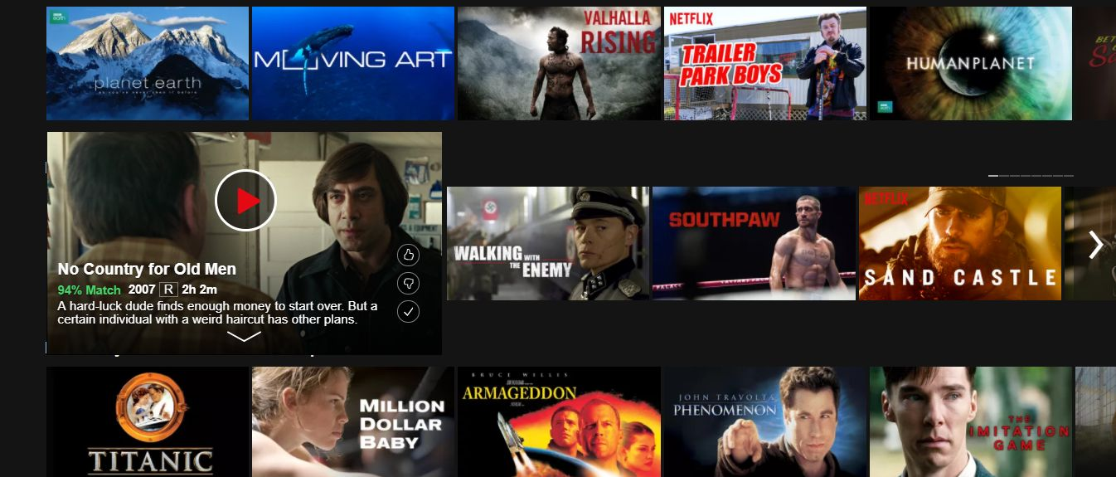
Click or hover-over tile expansion
Intuitive, minimalist nav anchor
Quick “Like”, “Dislike”, or “Favorite” icons
Splash summary; “Match” rating
Intuitive “See More” arrow
Image-heavy, use of tiles, minimalist

Slide 14
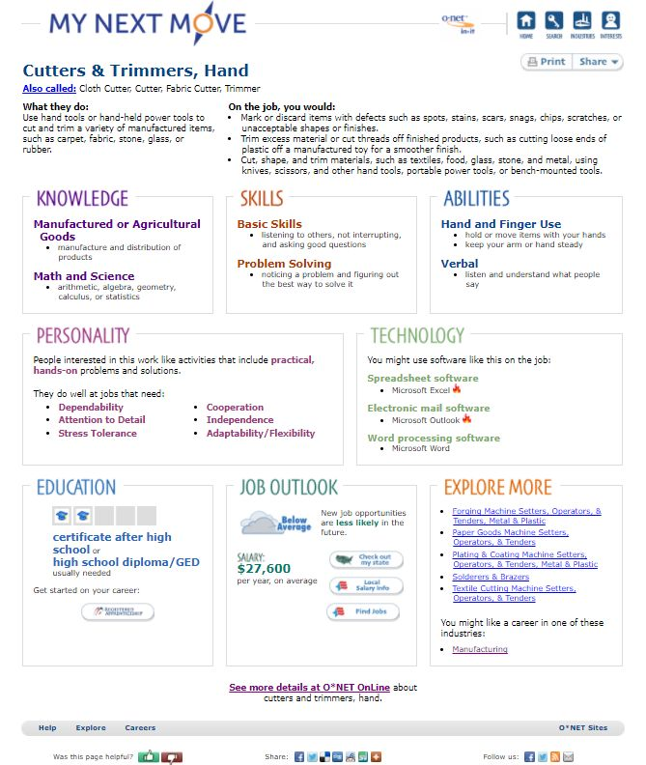
“Title”, “Alternate Titles”, & “Description” splash
Should include “Like”, “Dislike”, and “Favorite” anchors
Replaces variable names with more relaxed, contextual language
Amount of “Tasks” etc. should be per literacy score
Sections show only highest-scoring variables
Sections should be collapsible/expandable
BLS Employment Projection splash with intuitive icon
Admirable “Education” splash
Includes similar occupations
Call to action
Includes similar industries
A poor display of data; no plain language, little negative space, no images
Links to advanced profile

Slide 15

Users greeted with large, high-resolution image quickly contextualizing occupation
Minimalist header
Better summarize via sparklines or directional arrows
Splash stats drawn from BLS & ACS
Figures can be rounded for less decoding
“Jump to Section” anchors
Much cleaner occupation profile splash requiring less decoding

Slide 16
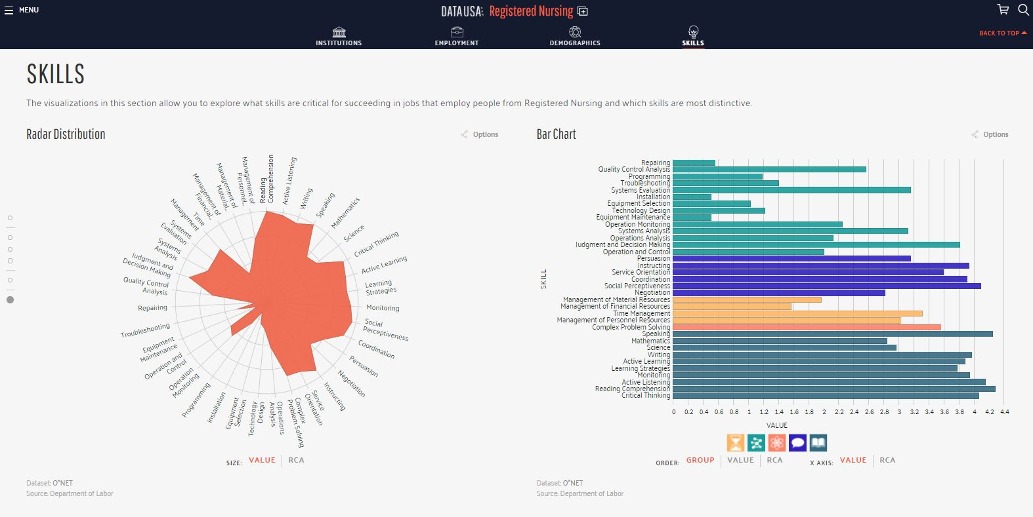
Fails to show only highest-scoring variables
Sleek, minimalist side nav
Interactive plots via javascript
Variables require either plain language or icons
Polar distribution unintuitive to adult learners; fails to prioritize variables
Uses icons in lieu of O*NET variable names
Attempted visualization at O*NET “Skills”

Slide 17
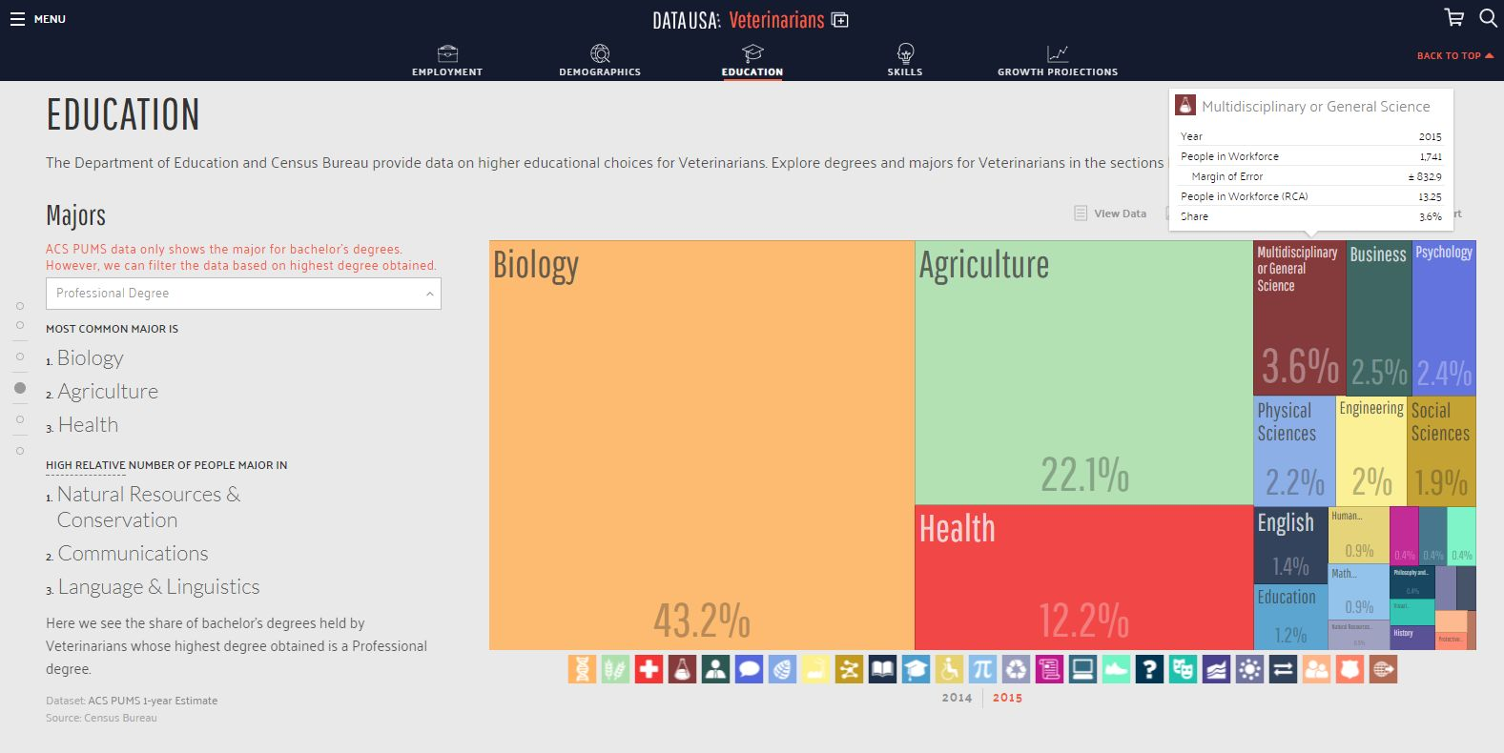
Savvy, minimalist header/”Jump to Section” nav
D3/Javascript-powered interactive visuals with hover-over splash
Should be filtered to show priority education pathways
Mosaic plot much more intuitive, savvy, and better depicts proportionality
Icons for each value
Autogenerated text narrates visualizations

Slide 18
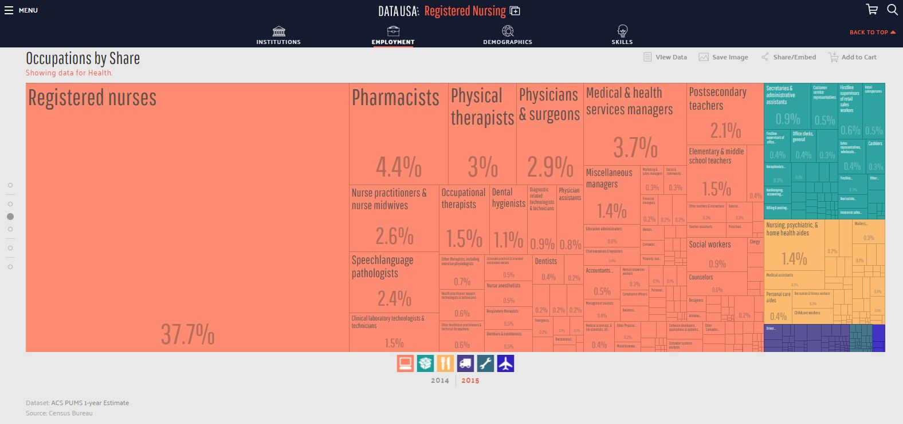
Icons for each industry
Needs to be more aggregated & prioritized.

Slide 19
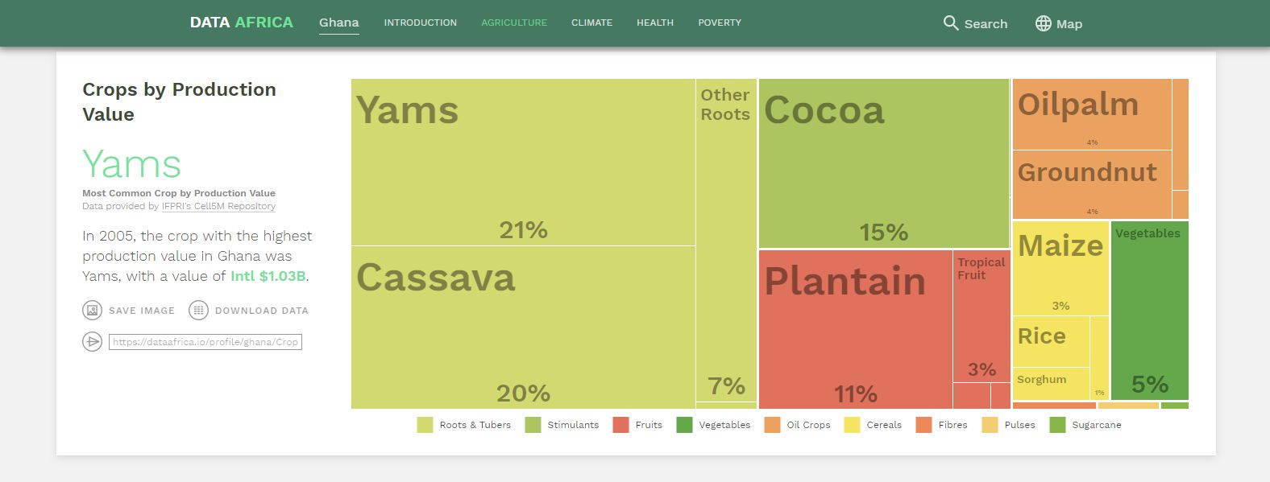
Significantly greater aggregation
Autogenerated text to explain visualization
Color-coded, plain-language legend

Slide 20
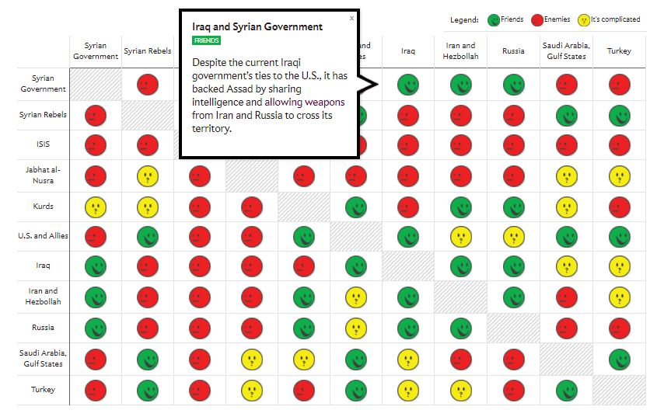
Interactive plot with hover-over explanation
Intuitive icons simplify decoding

Slide 21
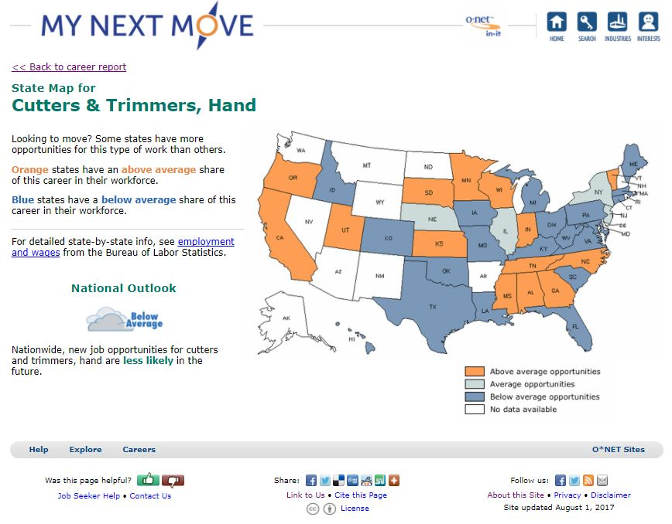
Highly-aggregated granularity doesn’t assist users with local data
Static image; not interactive
Crowded; redundant
Icons quickly convey data
Vague differentiation
Auto-generated text narrates visualization

Slide 22
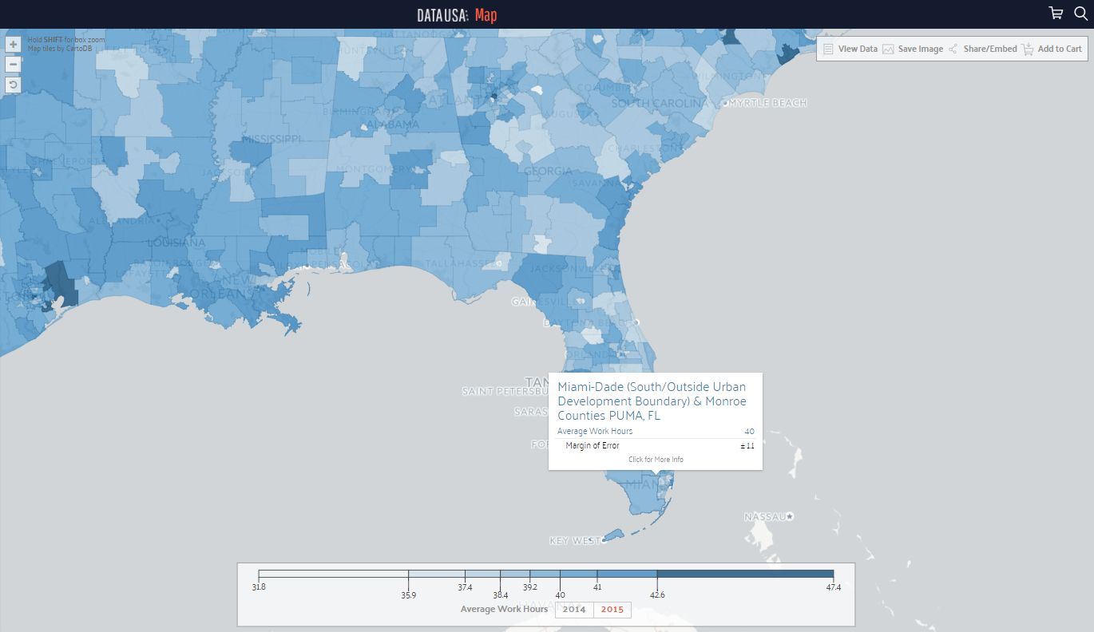
County-level granularity
Tooltips for interactivity
Hover-over splash tile
MOE & statistics jargon unnecessary
Interactive choropleth
More nuanced differentiation via Jenks natural breaks

Slide 23
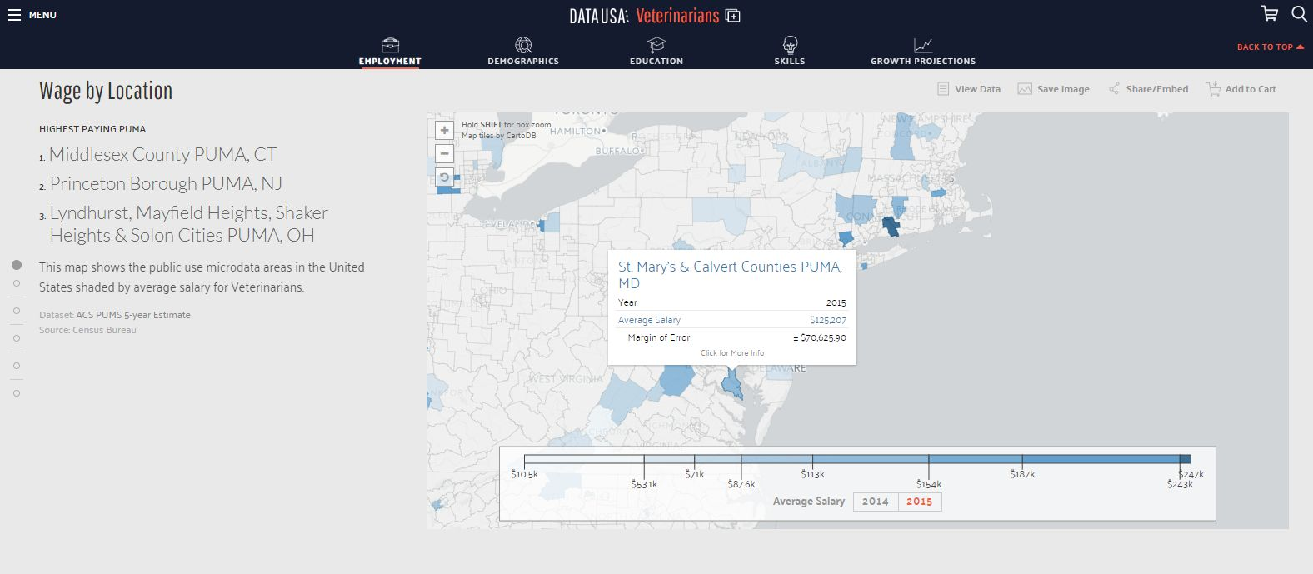
Autogenerated narrative & top-scoring observations
Savvy, minimalist side nav
May need more simplified breaks
Interactive choropleth

Slide 24
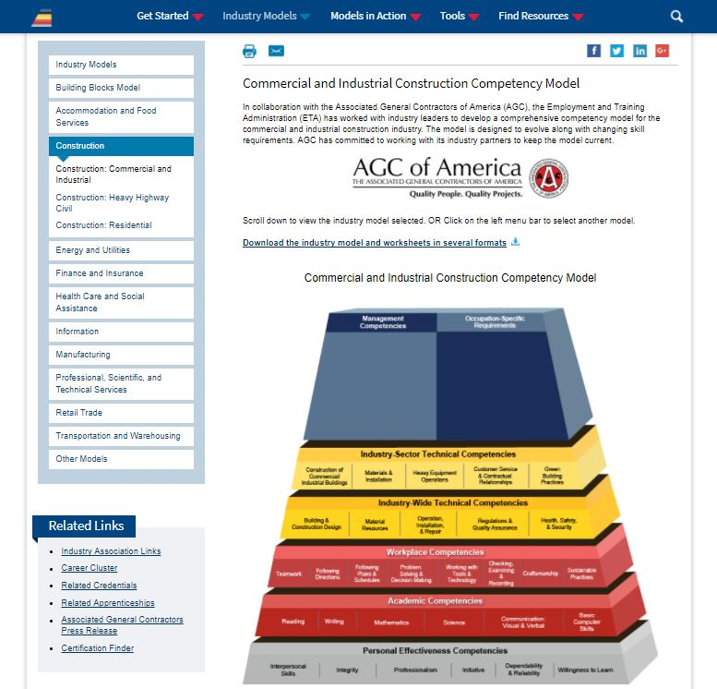
Interesting competency pathways model
Requires greater aggregation

Slide 25
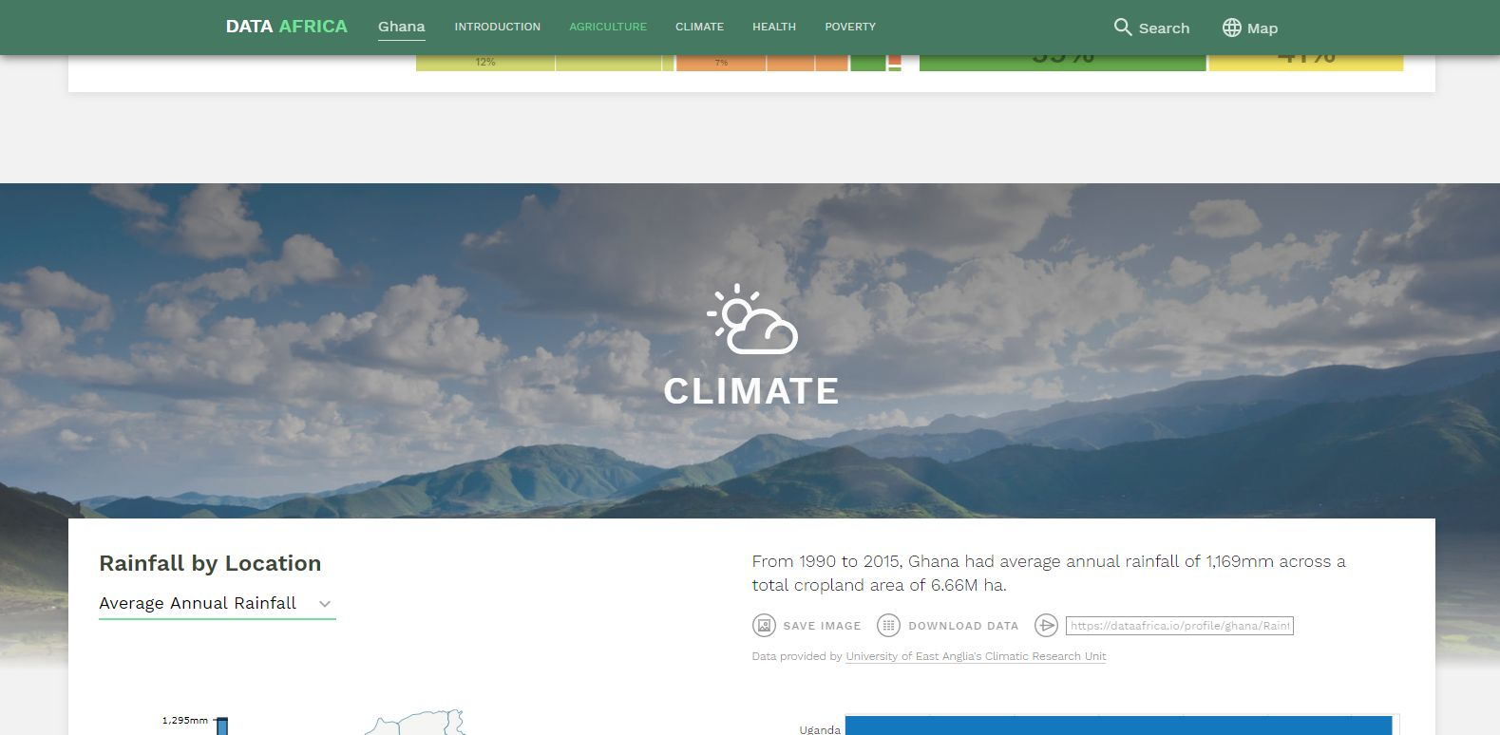
Section A
Section B
Use of large, high-resolution, textural imagery for natural section breaks
Image is unassuming, doesn’t draw attention from key info
Allows users to intuit distinction without interrupting cognitive fluency

